Slide 1
Week 9 & 10
DSC 640
Abed Tabbalat

Slide 2
Python

Slide 3

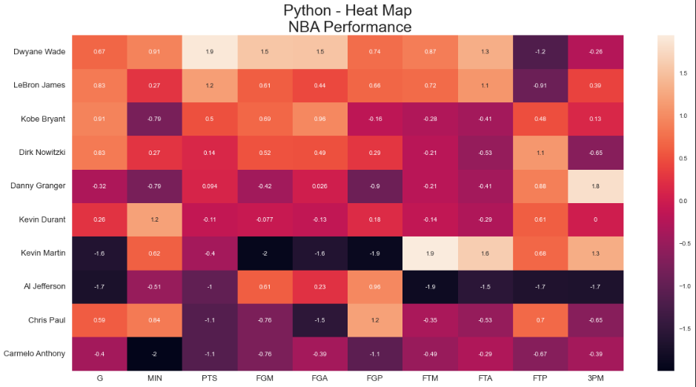
Python – Heat Map

Slide 4
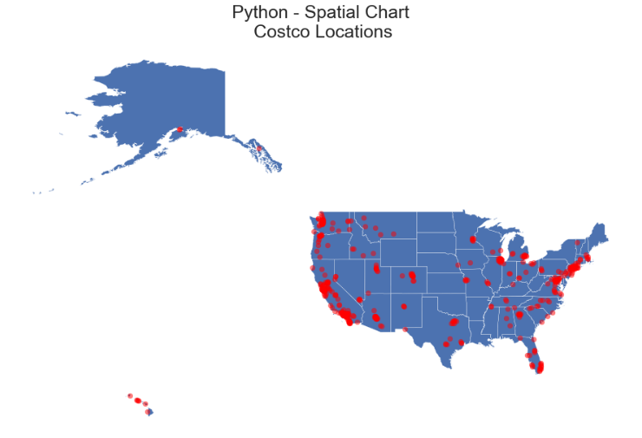
Python – Spatial Chart

Slide 5
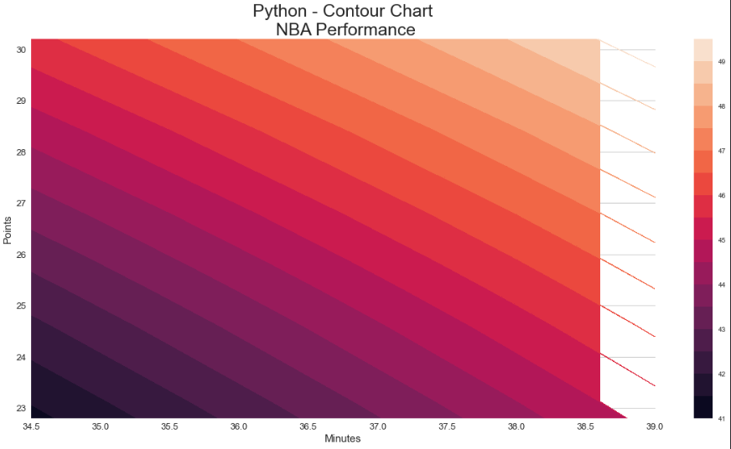
Python – contour chart

Slide 6
R

Slide 7
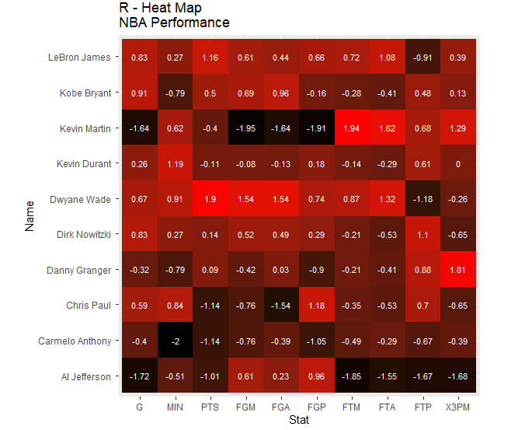
R – heat map

Slide 8
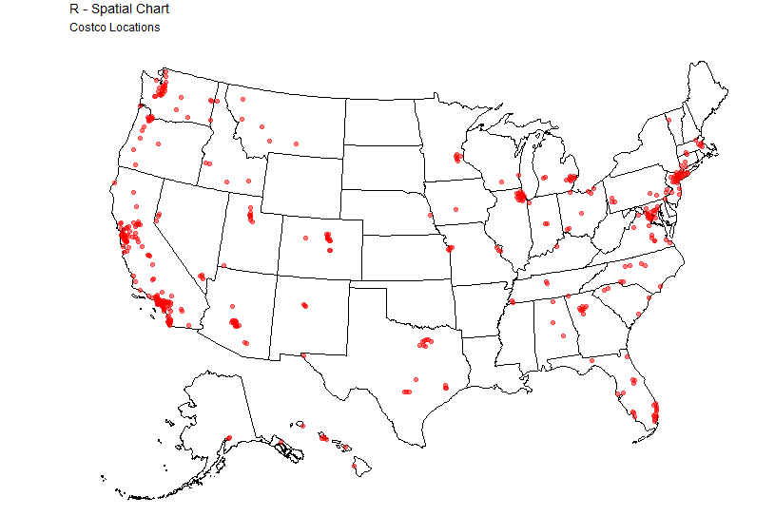
r – spatial chart

Slide 9
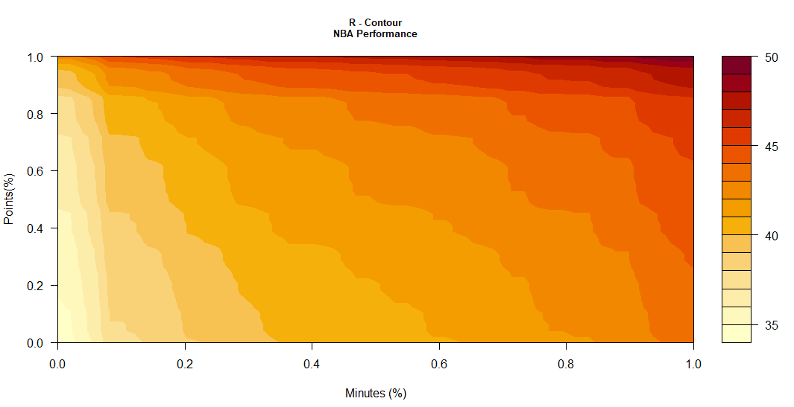
r – Contour chart

Slide 10
Tableau

Slide 11
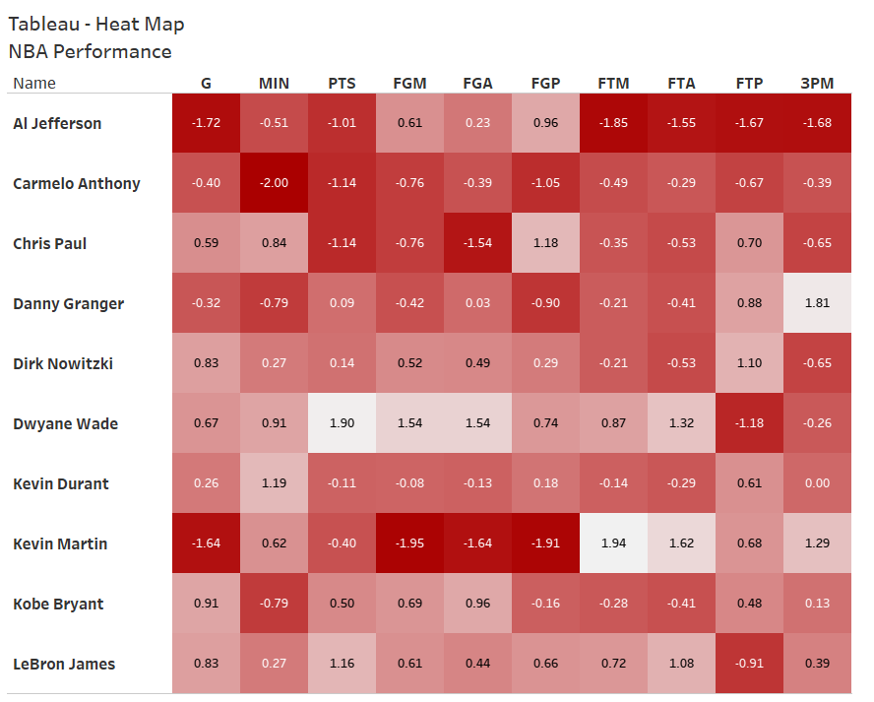
Tableau – Heat Map

Slide 12
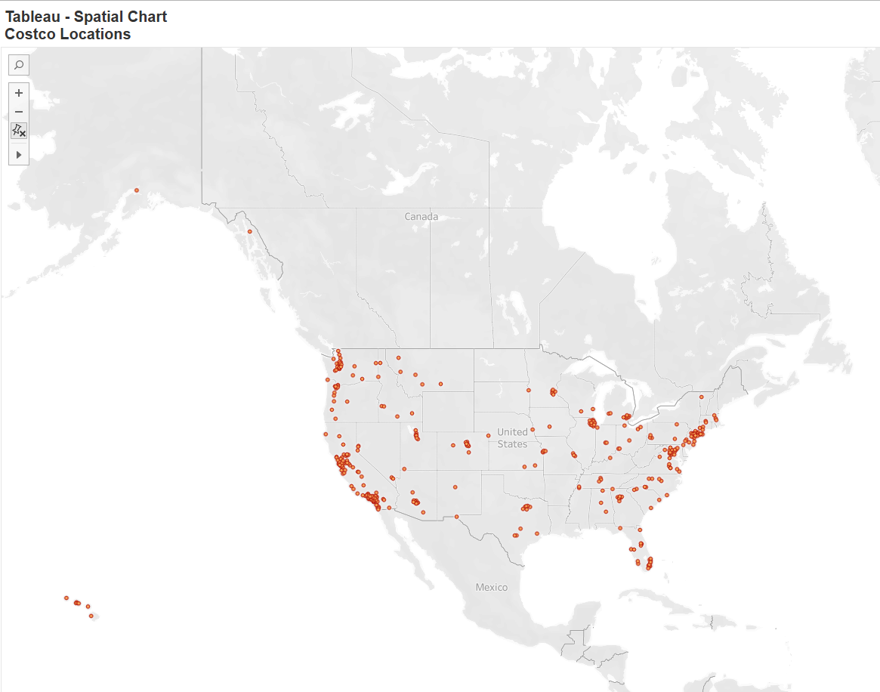
Tableau – Spatial Chart

Slide 13
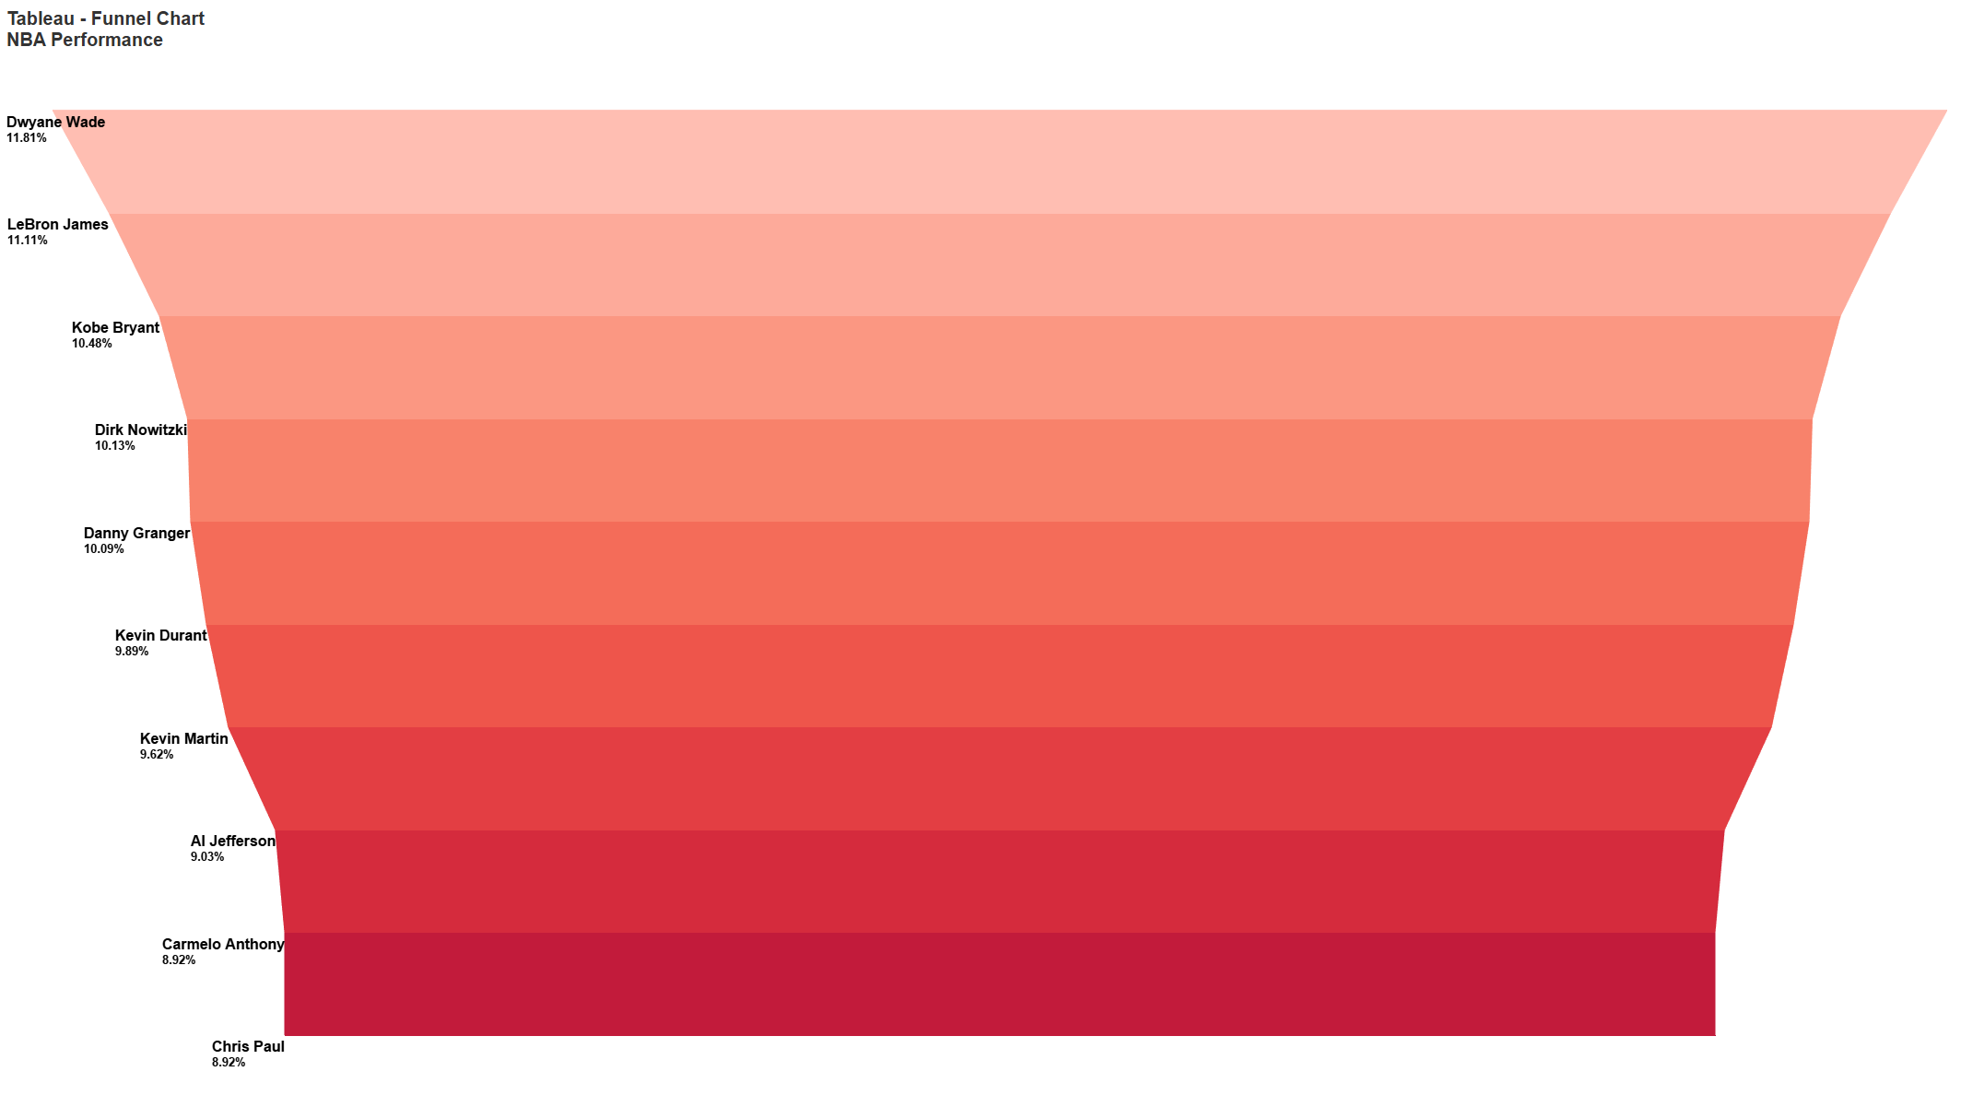
Tableau – funnel chart

